Slide 1



Introduction to ROS
Perception and Artificial Intelligence implemented in ROS

Slide 2
Rasperry Pi Camera
NVIDIA provides a package for interfacing with a CSI camera
This package also comes with optional pre-trained neural networks
https://github.com/dusty-nv/jetson-inference
Several launch files are available. Only 2 are of interest to us:
ros_deep_learning video_viewer.ros1.launch
ros_deep_learning video_source.ros1.launch
Notes:
These resources are available from this repository, featuring full installation instructions, however the necessary packages are pre-installed on the Puzzzlebot-002 image
Mini-task – preview the camera
Mini-task – preview the camera with ROS

Slide 3
ROS and OpenCV
OpenCV is a widely-used open-source computer vision library
It is pre-installed on the Jetson, but needs downgrading to work with melodic
To enable OpenCV in the ROS environment on the Jetson, add the following to the CMakeLists.txt in the package where OpenCV is required:
set(OpenCV_DIR /usr/share/OpenCV)
find_package(catkin REQUIRED COMPONENTS(OpenCV)
Once this line is added, import cv2 at the top of a python file will enable OpenCV methods to be used
Notes:
OpenCV can be programmed in either c++ or python and features powerful image manipulation tools.
ROS melodic only works with OpenCV 3, so the OpenCV 4 that comes with the Jetson must be downgraded to make it compatible. This is already done in the puzzlebot CV image
As usual with ROS, to access the OpenCV libraries, they must be added to the cmakelists file, in the format shown. We also need to specify the directory as OpenCV is not a ROS package so we have to inform the compiler where the OpenCV files are located.

Slide 4
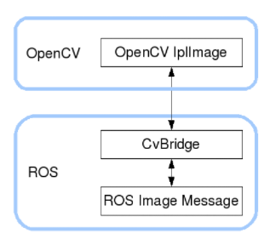
Accessing Images in ROS
The ROS package cv_bridge provides tools to enable OpenCV to manipulate images transmitted using ROS
sudo apt install ros-melodic-cv-bridge
bridge = cv_bridge.CvBridge()
image = bridge.imgmsg_to_cv2(msg,desired_encoding='bgr8’)
img_back = bridge.cv2_to_imgmsg(result_image)
Notes:
Image format is important when reading images, and ROS uses different standards to OpenCV
The cv-bridge ROS package provides the functions necessary to convert between ROS image messages and opencv-compatible images
The package is installed through the normal method
These commands convert between ROS and OpenCV

Slide 5
Activity: ROS Image processing
Add a node that publishes a set-point to the PID controller
If the node sees a large amount of red, it should command the controller to stop
ROS Image
Convert to OpenCV
Resize
Gaussian Blur
Colour Filter
Convert to ROS
Other Processing
Controller Set point
ROS Image
Notes:
This activity will start the process of adding an outer loop to correct for the imperfection in the inner loop
It will involve a simple node that publishes a set-point to the previously created PID controller. The robot should drive in a square as before, but if enough red is detected on the camera, it should stop
This diagram shows the basic flow of a ROS node
Firstly, as discussed previously, the cv bridge package is used to convert a ROS image to an OpenCV image (which will be updated by the ROS callback function)
Secondly, it is often useful to work with a fixed size of image, as different resolutions can change the way our image process works. If the image is re-sized to a fixed size, any camera or resolution can be input and the code should still function
Thirdly, some form of blur is applied. This can help remove excessive noise from the image while retaining key features that we need to observe
Next, a colour filter is often applied. What colour this is depends on the application, often it is greyscale (e.g. for detecting a white line), but it could also be any other colour. Finally we get to the actual image processing. This varies depending on our application
Once the image processing is done, we can output any desired information that we have gained from our image processing. For us this will often be a controller set-point, but could be information about objects or signage detected by the algorithm
Image processing is applied to the input image, and there will be visible effects on that image.
It is therefore useful to publish the image back to ROS as we can then see the effect of our image processing algorithms.
Also, it can be useful to draw the information we are outputting on the image itself (e.g. the position of a line), as the visualisation of the algorithm can be very useful for debugging
However, this will use up some computing resources, so it is advisable to switch this off once debugging is complete to maximise the efficiency of the algorithm

Slide 6
Activity: ROS Image processing
Add a node that publishes a set-point to the PID controller
If the node sees a large amount of red, it should command the controller to stop
cv2.resize
cv2.GaussianBlur
cv2.cvtColor
ROS Image
Convert to OpenCV
Resize
Gaussian Blur
Convert to HSV
cv_bridge.imgmsg_to_cv2
cv2.inRange
Convert to ROS
Mask for RED
Controller Set point
Param | Lower Limit | Upper Limit
H | 140 | 200
S | 140 | 255
V | 70 | 255
ROS Image
cv_bridge.cv2_to_imgmsg
Notes:
In this case we suggest doing the following:
Convert the image to HSV
Apply a bitwise AND between specific ranges to filter the RED
Count how many pixels in the resulting mask are non-zero (to determine the amount of red on the screen)
Apply a threshold such that when the amount of red is above a certain amount, a stop signal can be sent to the robot

Slide 7
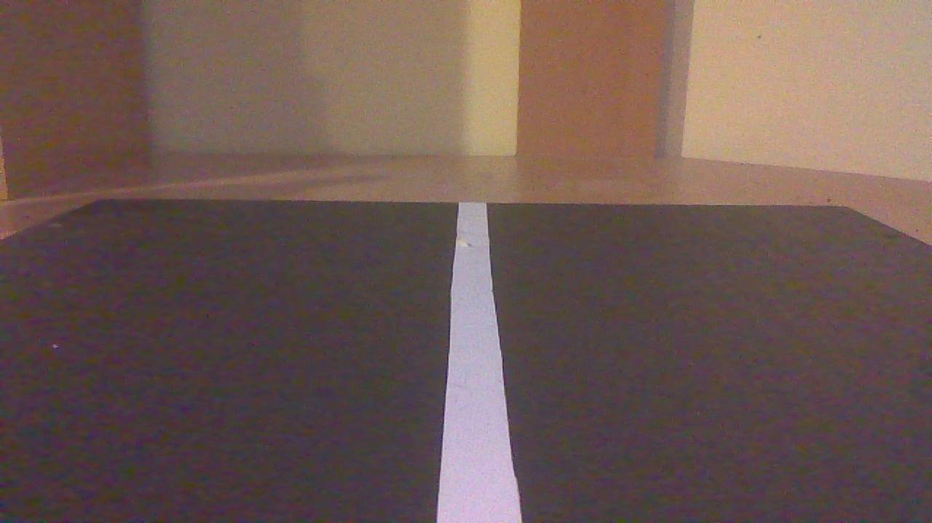
Line Detection
???
Notes:
For line detection, we must take an image as shown, and convert it into something that can be used as a set-point to our control loop.
A simple setup would have the robot move forwards at a fixed speed and use the position of the line to turn.
Hence, our image processing should provide a value that indicates the horizontal position of the white line on the camera.
This can be in pixels as the controller gains can simply be tuned to adjust to the scale.

Slide 8
Line Detection
Recall this diagram from yesterday:
ROS Image
Convert to OpenCV
Resize
Gaussian Blur
Colour Filter
Convert to ROS
Other Processing
Controller Set point
ROS Image
Notes:
Firstly, since the line is bright on a dark background, we can apply a grayscale filter to remove the unnecessary information about colour
Next, we will work on the “Other processing” section

Slide 9
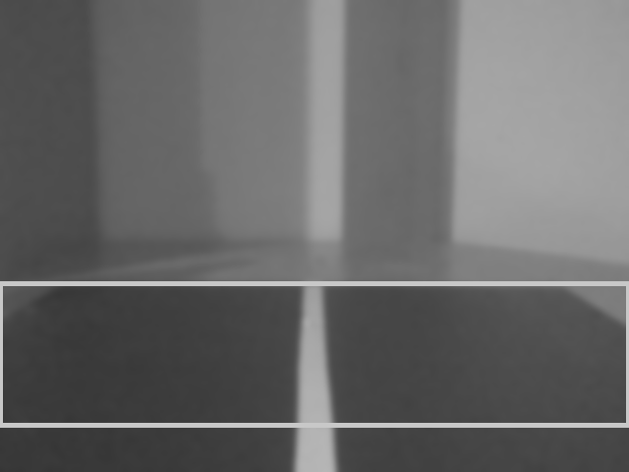
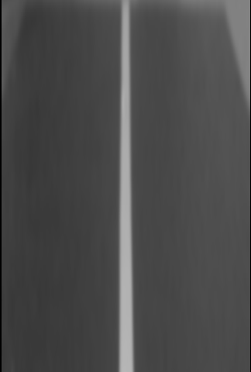
Region of Interest
Notes:
Firstly, notice that there are many objects in the field of view of the camera, most of which we are not interested in for this task. The only thing we are interested in is the track in front
Hence, it is useful to remove the unnecessary objects from the image by cropping it to a specific ROI. In this case, a simple rectangle will do the job nicely

Slide 10
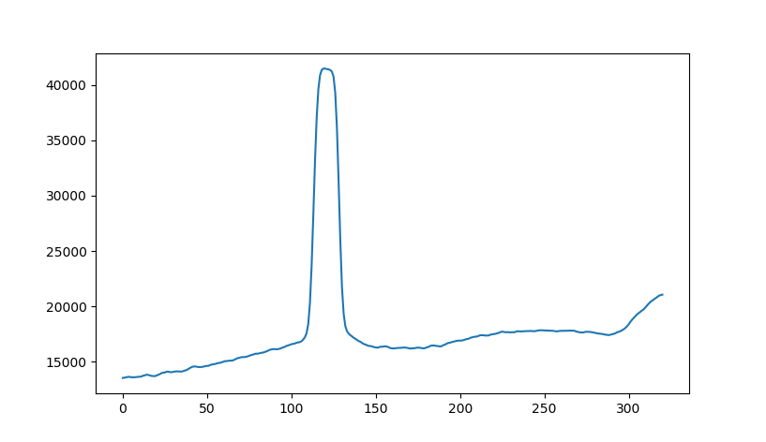
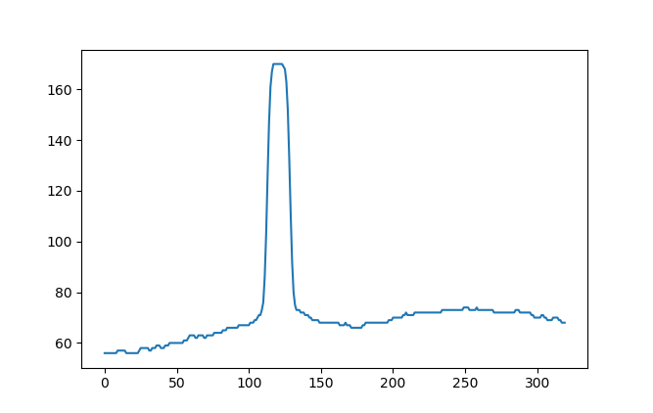
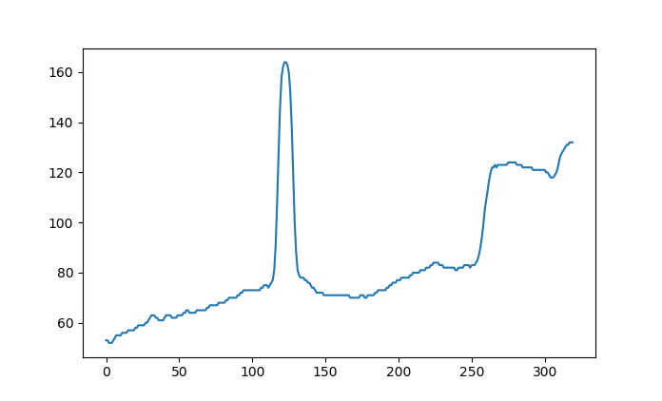
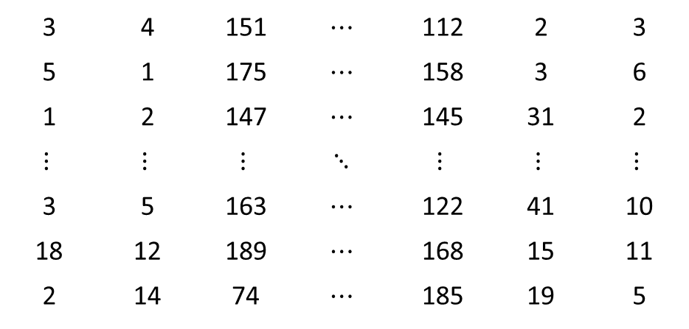
Convert to graph
The picture is now a matrix of values between 0 and 255
Each row will have higher values around the line
Exaggerate this by summing vertically
This is easily done using a python library called numpy
3 | 4 | 151 | $$⋯$$ | 112 | 2 | 3
5 | 1 | 175 | $$⋯$$ | 158 | 3 | 6
1 | 2 | 147 | $$⋯$$ | 145 | 31 | 2
$$⋮$$ | $$⋮$$ | $$⋮$$ | $$⋱$$ | $$⋮$$ | $$⋮$$ | $$⋮$$
3 | 5 | 163 | $$⋯$$ | 122 | 41 | 10
18 | 12 | 189 | $$⋯$$ | 168 | 15 | 11
2 | 14 | 74 | $$⋯$$ | 185 | 19 | 5
Image
height
Image Width
Notes:
Since each row of pixels will have high values in the middle, and the white line now covers the entire image, summing vertically will greatly exaggerate the effect of the white line and help to remove any noise, since noise is unlikely to take up the entire image vertically
NumPy is a python library that provides complex numerical operations efficiently, and is very widely used in the python workspace. Numpy can interact directly with OpenCV images, and OpenCV can interpret numpy arrays as images
Now that we have these as numpy arrays, we have a mathematical problem of detecting the line

Slide 11
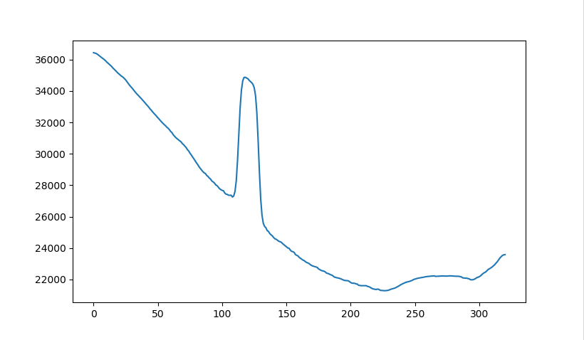
Activity: Peaks
The simplest solution is to just use the peak
ROS Image
Convert to OpenCV
Resize
Gaussian Blur
Greyscale Filter & ROI
Convert to ROS
Plot on original image
Extract Peak
Sum vertically
ROS Image
Controller Set point
Problems with this solution?
Notes:
Numpy provides a function to find the peak value in an array, which returns the index where the maximum value of the array is
Since the indeces represent pixels, this is an easy solution.
Activity: Write the node shown by the diagram, to find the simple solution to the line problem
Potential problems with this solution:
Uneven lighting sometimes the road surface can appear brighter than the line, especially if it is slightly reflective, which would put the peak higher than the line
Multiple lines – we could get the top two peaks but then noise often becomes even more of an issue, especially if we lose sight of one of the lines
Noise – no way to reject small spikes with this method since we do not know the width of the line. If the width of the line could be determined, we could reject noise which is smaller or larger than a given value

Slide 12
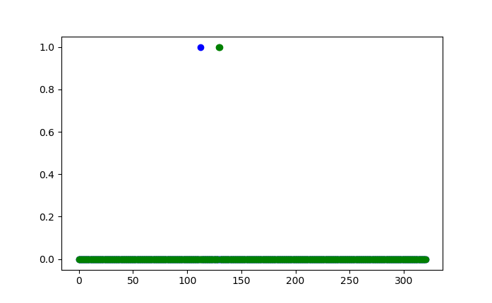
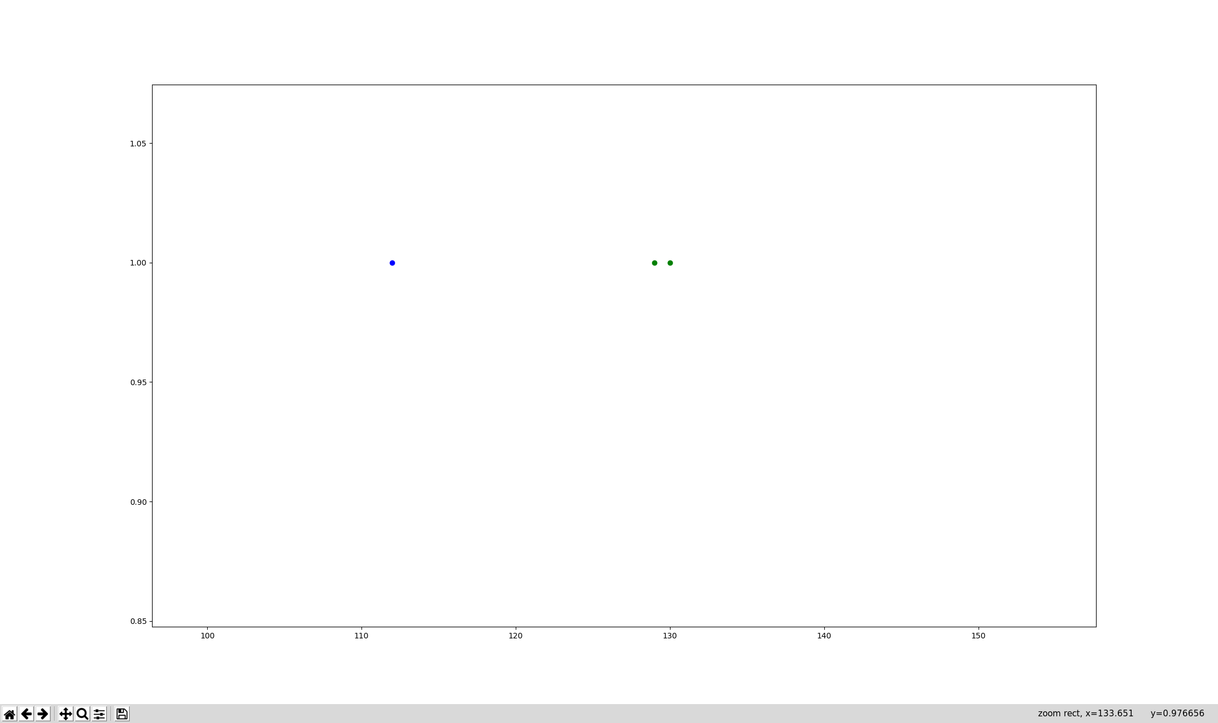
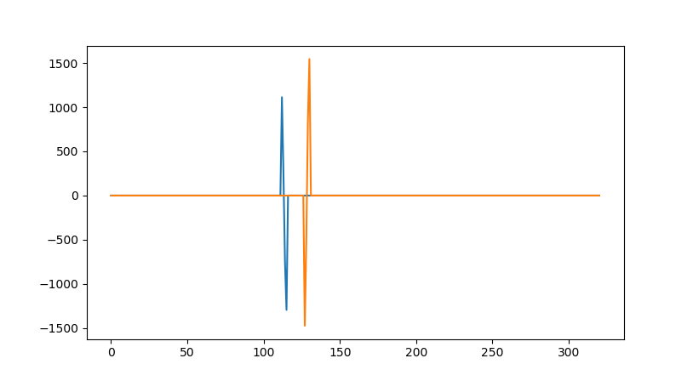
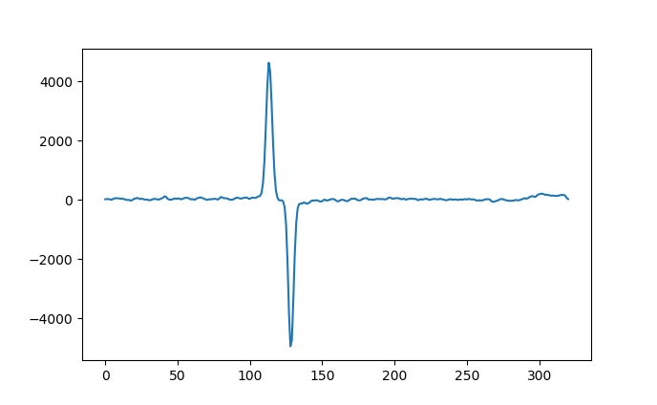
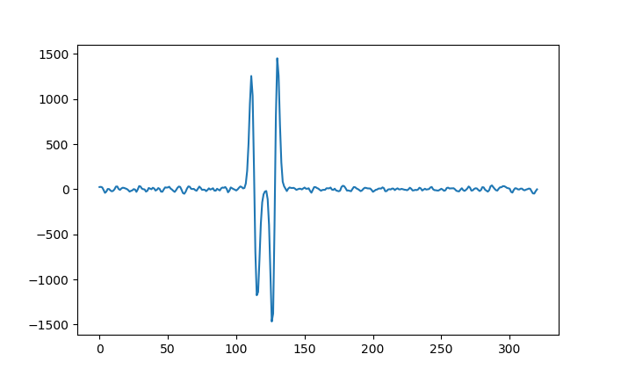
Increasing reliability
If additional information could be extracted, the algorithm may become more reliable
Using the derivative and second derivative can do this for us
Notes:
Additional information could be used to filter out noise and further decrease the likelihood of a false positive
For example, if we can find the edges of the line, we can use known factors such as the line width to filter out excess noise
There are naturally multiple ways to go about this, and we will cover one example here:
Using the gradient and the second gradient, we can extract additional information from the line plot
As seen here (TODO insert plot), the gradient spikes positively and negatively at each side of the line
Applying a threshold to this will remove a large proportion of the noise
Additionally, the second derivative shows where the gradient is at it’s peak (by finding the turning points)
There are many options to combine this information. One might be to multiply them together, which gives the following plot
There are two spikes per edge (one for the positive gradient and one for the negative. We only need one, so lets remove the negative
Now nearly done, but we still have a small collection of points for each edge, so lets get rid of those. One way to do this is to shift the graph one pixel to the right.
Next, just compare the two. If we create an array that is 1 everywhere the original graph is greater than the shifted graph, that gives us 1 pixel for each spike
Now, we have two arrays of left and right edges

Slide 13
Further processing
Every left edge must have a right edge associated with it
Consecutive edges should be of alternating types
The line has a maximum and minimum width
Exception handling is essential
Notes:
Use known facts about the dimensions of the track to further clean up the results
This is often not necessary with such a simple track as this, however if more complex challenges are required, such as following a lane made up of two lines, or the addition of other road markings, it quickly becomes necessary
Examples of further processing:
Left edges and right edges that are on their own are likely not lines and should be removed
Edges that are too far or too close from their counterparts are likely noise and should be removed
Occasionally, this method gives two spikes for one edge, so if any pair of same-side edges next to each other is detected, one should be removed
Bear in mind that no algorithm is perfect, and there may still be times that you end up with a different number of left and right edges.
Your code should account for this and handle it appropriately
For example, it could store nan in the value for line location. NaN is a generally accepted term for the result of an impossible operation, such as dividing by zero.

